Slide 1
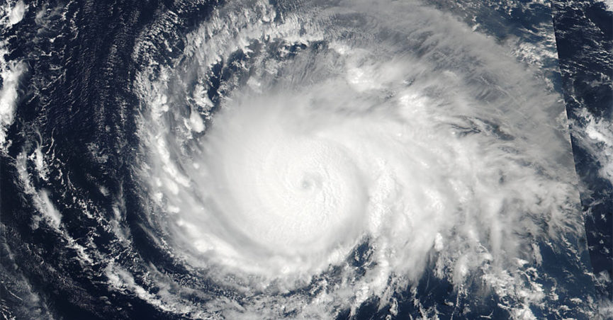
Hurricane Irma declared as Category 4
Last Update Time:
Sat, Sept 09 6:00 am (MDT)
FOUO
Notes:
Tracking Hurricane Irma
400 PM EDT POSITION UPDATE... ...WINDS BEGINNING TO INCREASE IN THE KEYS AND THE SOUTHERN FLORIDA PENINSULA...

Slide 2
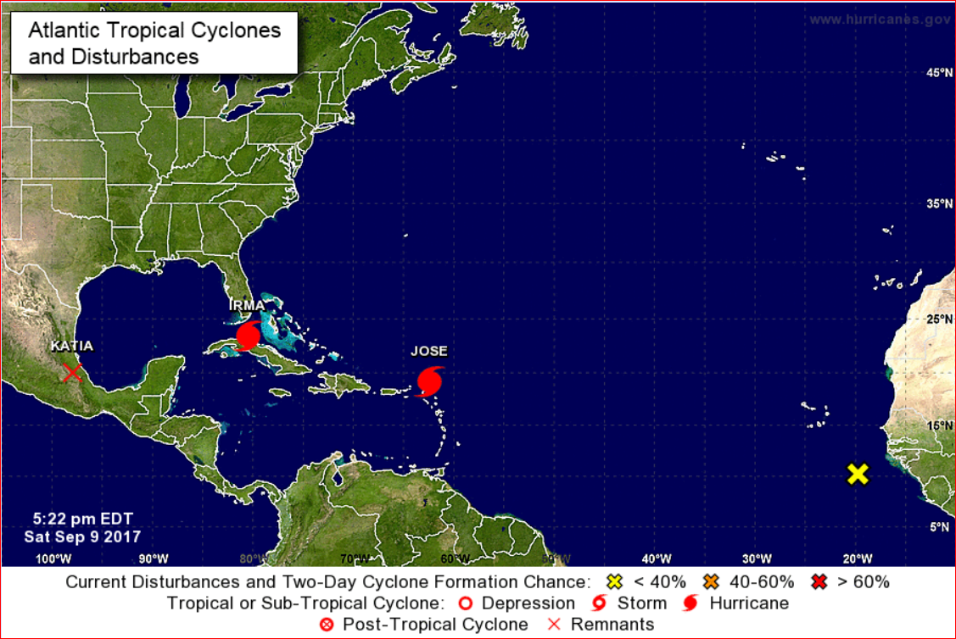
Hurricane Irma
Last Update Time:
Sat, Sept 09 2:00 pm (EDT)
FOUO
Notes:
Hurricane and Cyclone Public Information Map Source NOAA
This map describes the current & recent location of tropical storms, as well as forecast positions and probable track of tropical storms.
This map is provided by the Branch of Geospatial Support
Last Update Time:
Sat Sept 9 2017 6:00pm EDT
600 PM EDT POSITION UPDATE... ...TROPICAL STORM CONDITIONS NOW OCCURRING IN THE FLORIDA KEYS
Location: 23.4°N 80.7°W
Moving: WNW at 9 mph
Min pressure: 933 mb
Max sustained: 125 mph

Slide 3
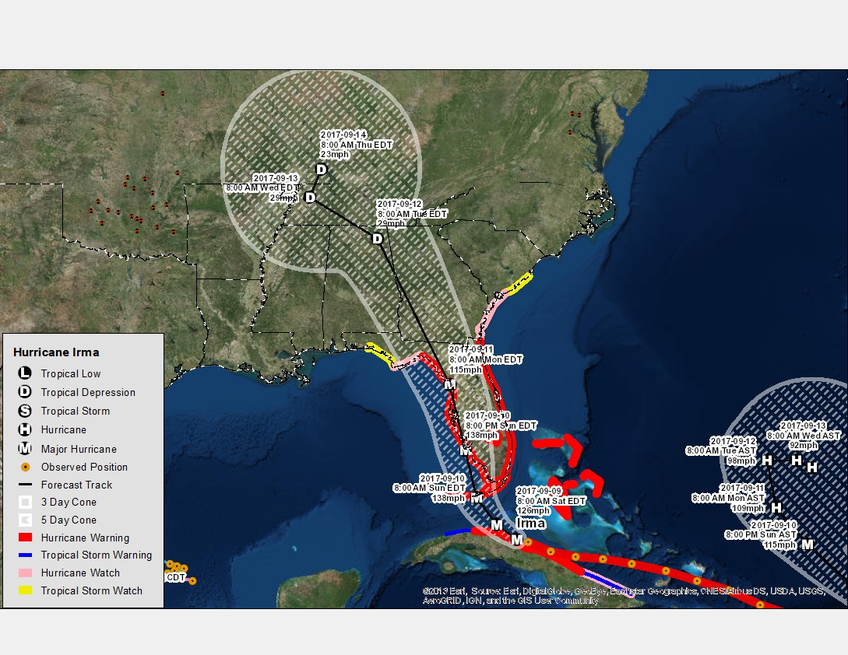
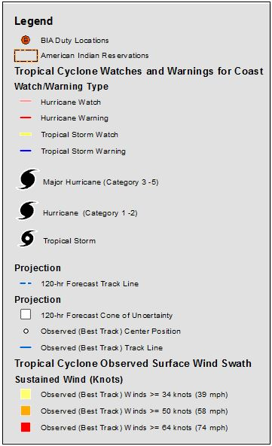
Hurricane Irma
Last Update Time:
Sat, Sept 09 2:00 pm (MDT)
FOUO
Notes:
Hurricane and Cyclone Public Information Map Source: NOAA
This map describes the current & recent location of tropical storms, as well as forecast positions and probable track of tropical storms.
The shaded area around the forecast track is called the "cone of uncertainty." The cone represents the probable track of the center of a tropical cyclone.
This map is provided by the Branch of Geospatial Support
Last Update Time:
2:00 PM AST Sat Sep 9
Location: 18.8°N 61.9°W
Moving: NW at 14 mph
Min pressure: 945 mb
Max sustained: 145 mph

Slide 4
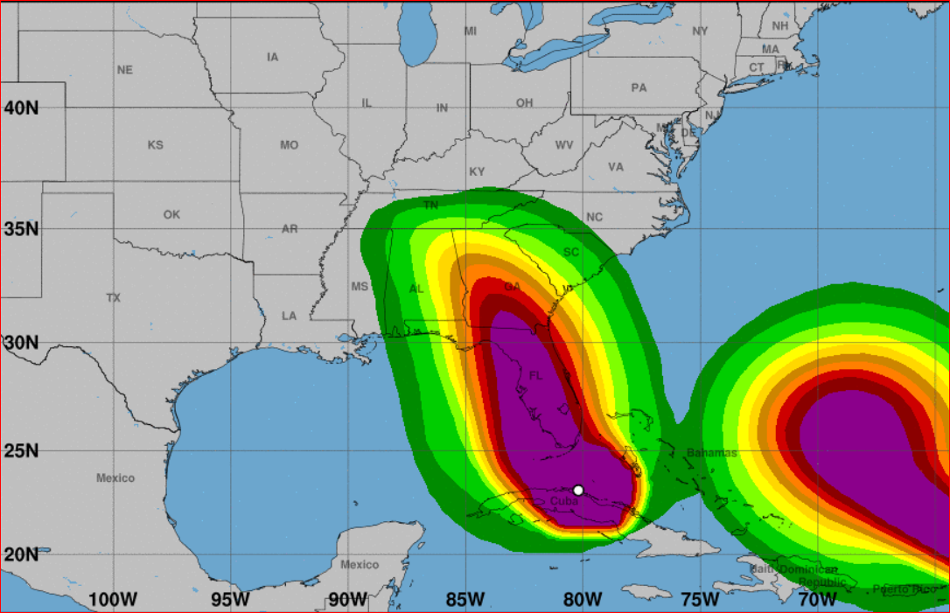
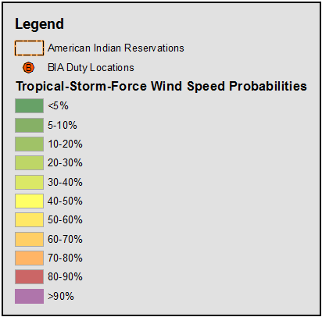
Hurricane Irma Most Likely Time of Tropical-Storm-Force Winds
Last Update Time:
Sat, Sept 09 2:00 (EDT)
Sun 8 PM
Sun 8 AM
Sun 2 AM
Sat 8 PM
Sat 2 PM
Sat 8 AM
FOUO
Notes:
The times displayed show the most likely time of arrival of tropical-storm-force winds for Hurricane Irma as of Saturday, Sept. 9 2017 at 6 AM MDT.
The map shows tropical storm force wind speed probabilities for the next 120 hours (2 AM AST Sat, Sept 08 – 2 AM AST Wednesday, Sept 13)
Wind speeds range from 34-64 knots.
Source NOAA
Last Update Time:
2:00 PM AST Sat Sep 9
Location: 18.8°N 61.9°W
Moving: NW at 14 mph
Min pressure: 945 mb
Max sustained: 145 mph

Slide 5
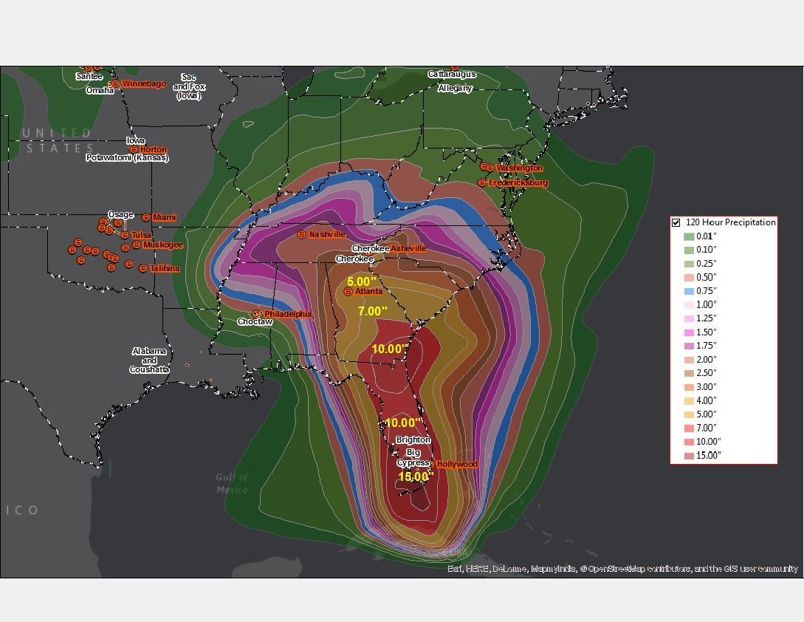
Hurricane Irma
120 hour Precipitation Amount
Last Update Time:
Sat, Sept 09 2:00 pm (MDT)
FOUO
Notes:
The map shows precipitation amounts for the next 120 hours
(2 AM AST Sat, Sept 09 – 2 AM AST Thru, Sept 14)
Miccosukee: 10 inches
Big Cypress: 10 inches
Brighton: 10 inches
Source: NOAA
Last Update Time:
2:00 PM AST Sat Sep 9

Slide 6
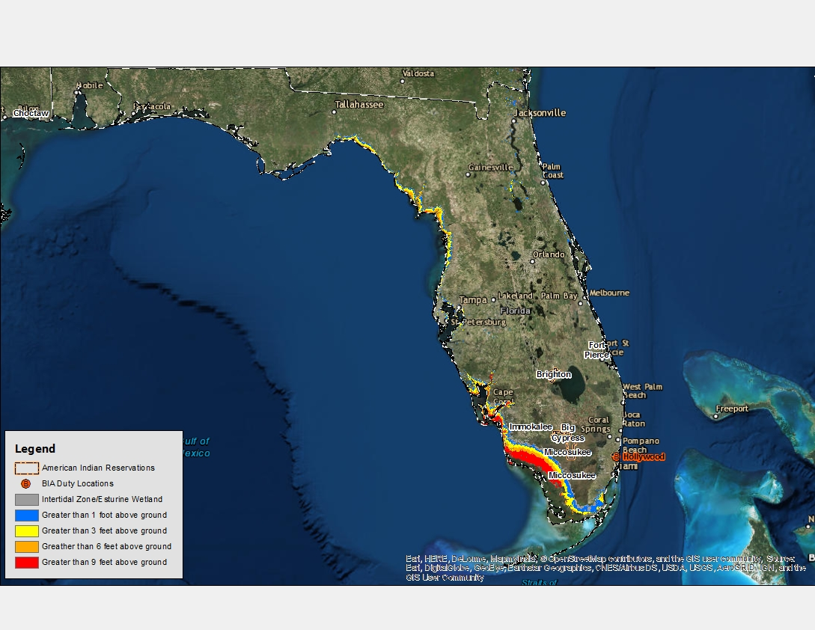
Hurricane Irma
Potential Storm Surge Flooding
Last Update Time:
Sat, Sept 09 2:00 pm (MDT)
FOUO
Notes:
The map shows Potential Storm Surge Flooding
Source: NOAA
Last Update Time:
2:00 PM AST Sat Sep 9

