Slide 1
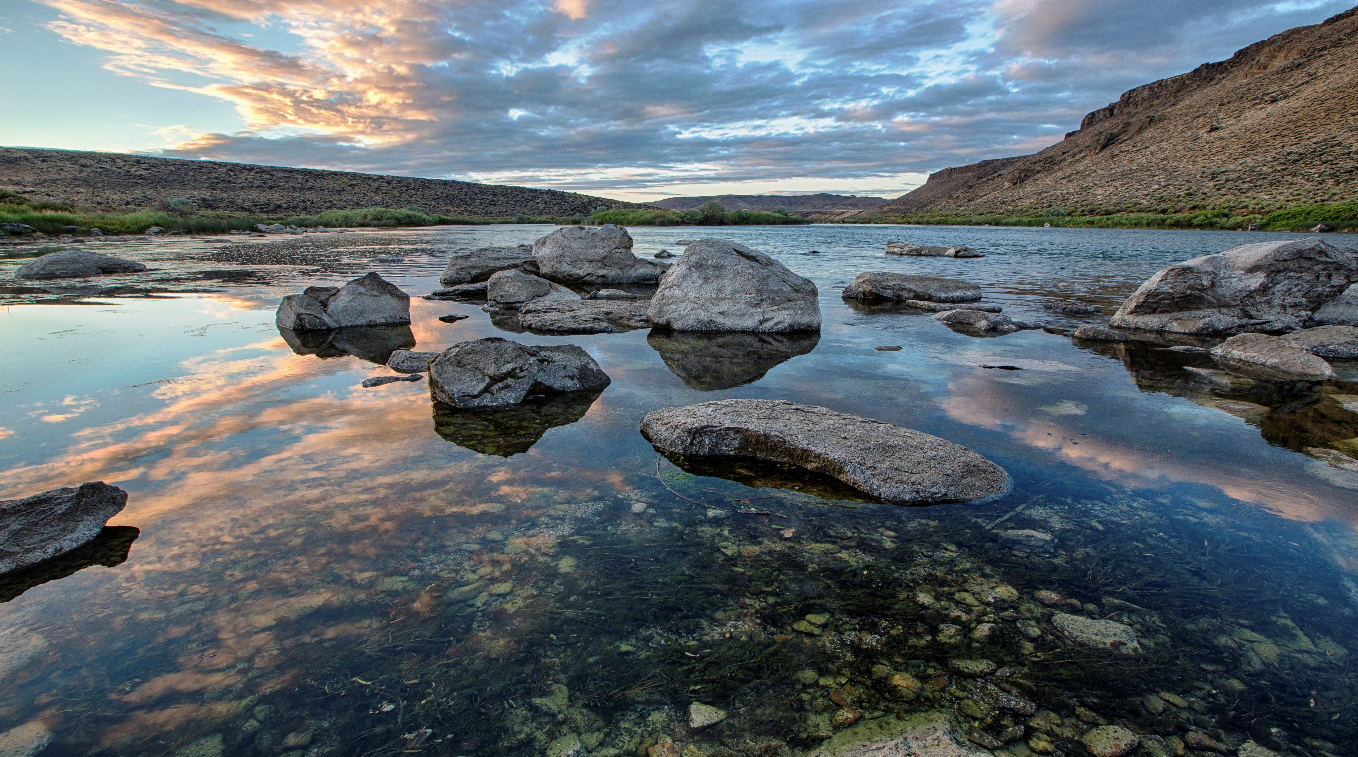
Tribal Consultation on Proposed Departmental Policy on Indigenous Knowledge
US Department of the Interior
Office of Policy Analysis
February 25, 2023

Slide 2
Departmental Policy on Indigenous Knowledge (IK)
Summary
Establishes responsibilities for considering and including IK in Departmental actions and scientific research
What is the Department Manual?
User manual for the Department of the Interior
Organization, function, and authorities of the Department
Direction on how to implement requirements
Example: 516 DM 7 directs how the Office of Native Hawaiian Relations manages the National Environmental Policy Act (NEPA) process for land exchanges involving Hawaiian Homelands

Slide 3
Defines Indigenous Peoples as: Native Americans, Alaska Natives, Native Hawaiians, and Indigenous Peoples of the U.S. Territories, and their respective nations, communities, or groups that are indigenous to the United States and its territories.
Departmental Policy on Indigenous Knowledge (IK)
Summary

Slide 4
Departmental Policy on Indigenous Knowledge (IK)
Summary
Defines Indigenous Knowledge as: a body of observations, oral and written knowledge, innovations, practices, and beliefs developed by Indigenous Peoples through interaction and experience with the environment. It is applied to phenomena across biological, physical, social, cultural, and spiritual systems. Indigenous Knowledge can be developed over millennia, continues to develop, and includes understanding based on evidence acquired through direct contact with the environment and long-term experiences, as well as extensive observations, lessons, and skills passed from generation to generation.

Slide 5
Departmental Policy on Indigenous Knowledge (IK)
Highlights
Policy is consistent with Office of Science Technology Policy-Council on Environmental Quality (OSTP-CEQ) “Guidance for Federal Departments and Agencies on Indigenous Knowledge” released 11/30/22.
Elevates IK in implementation of Department activities.
Stresses collaborative relationships with Indigenous Peoples built on reciprocity, equity and mutual respect.
Requires free, prior, and informed consent before learning or including IK.

Slide 6
Departmental Policy on Indigenous Knowledge (IK)
Highlights
Learn IK through appropriate processes and procedures through collaboration with Indigenous Peoples.
Include IK in a manner compliant with federal laws including the Information Quality Act.
Ensure Departmental employees receive training on learning and including IK before engagement.
Bureaus and Offices will develop further guidance for IK inclusion.
Establishes new Departmental Indigenous Knowledge Coordination Committee.

Slide 7
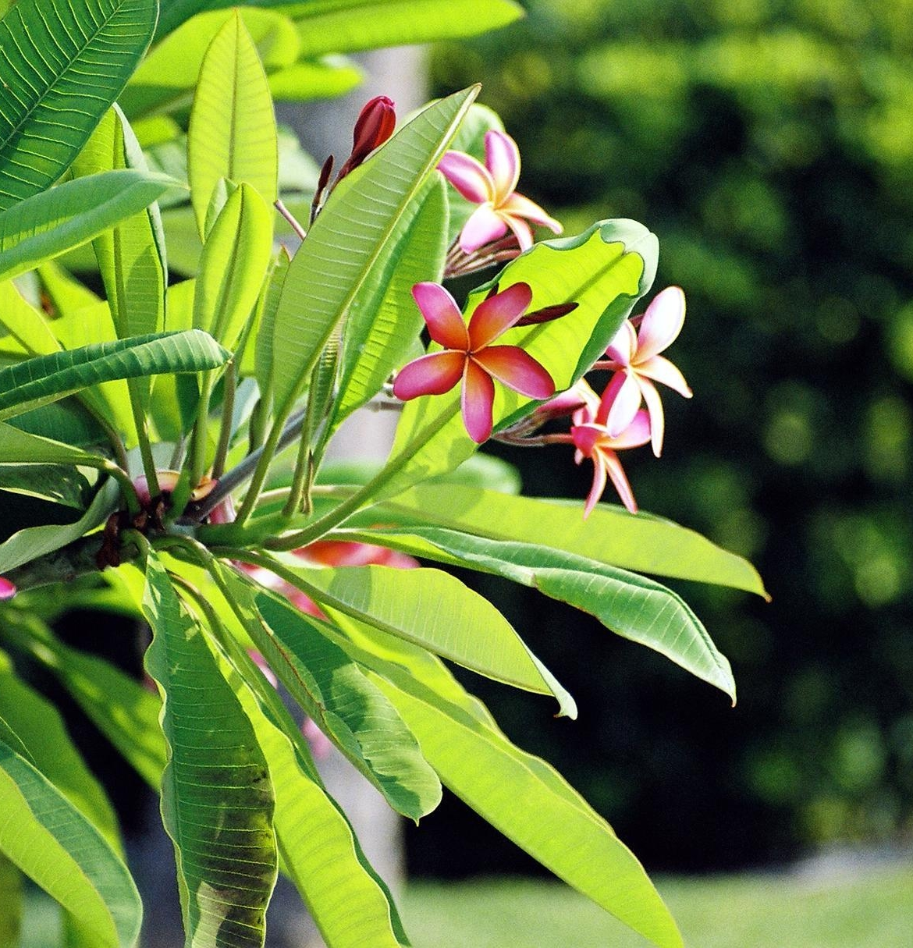
We are seeking input
on the following:
How would you like to work with the Department to ensure that Indigenous Knowledge properly informs Departmental policies, programs, research, and decision-making?
How can the Department work with you to identify appropriate knowledge holders and to obtain appropriate consent for the inclusion of Indigenous Knowledge?

Slide 8
We are seeking input
on the following:
3. How can the Department work with you to value and protect this knowledge? What ethical considerations should guide the Department’s efforts?
4. For which specific federal laws, regulations, policies, or research/scientific processes can Indigenous Knowledge inform the Department’s decision making? How should Indigenous Knowledge be included in these authorities and processes?

Slide 9
Next Steps
Written comments are due by 11:59 ET on March 26, 2023
Submit written comments to consultation@bia.gov
Feel free to reach out to:
Nicole Herman-Mercer nhmercer@usgs.gov
&
Maria Wiseman
Maria.Wiseman@bia.gov
We appreciate your time and feedback,
Mahalo!
Thank you!

